Slide 1
Large scale clinical text processing and process optimization
Olga V. Patterson
Thomas Ginter
Scott L. DuVall
Aug 20, 2015
Notes:
Tutorial structure Aug 20 1pm – 4pm
Clinical NLP overview
Participants will be introduced to the goals, tasks, and methods of text processing. Characteristics that distinguish clinical text from general language and complicate text processing will be outlined.
Challenges of large scale NLP
The time required to perform different NLP tasks will be presented. The logistics of storing, transporting, and processing will be discussed. The challenges of processing large amounts of data will be described.
Scalable design
Participants will be introduced to scalable design terminology, characteristics, and variety of approaches. The differences between synchronous and asynchronous processing will be described.
Overview of tools
Participants will have the ability to use several open-source tools as they are introduced and demonstrated. UIMA AS will be introduced along with a description of how it facilitates the creation of NLP pipelines. Jargon specific to UIMA will be presented and explained. Synchronous versus asynchronous processing with UIMA will be explained. The steps of configuring and deploying an asynchronous pipeline in UIMA will be discussed. Leo will then be introduced to demonstrate the convenience and efficiencies of configuring and launching pipelines programmatically. Leo capabilities will be demonstrated using examples. JAM monitoring capabilities and performance metrics will be described and the JAM user interface and reporting service will be demonstrated.
Scalable deployment
Participants will be walked through the steps of deploying an asynchronous pipeline. The pipeline will be a representative example of a document classification task using several analytical components. Defining the input and output of the system along with how the modules interact will be demonstrated. Pipeline configuration and different deployment approaches will be presented.
System monitoring
Participants will be walked through the process of monitoring and analyzing performance characteristics of a deployed parallelized pipeline with JAM. The specific performance measures will be explained and discussed. Participants will be tasked to identify specific components that act as processing bottlenecks.
System reconfiguration and optimization
Participants will be walked through the steps of performance optimization using component and pipeline replication and alternate deployment approaches. Performance improvement will be measured to ensure bottlenecks are resolved. The iterative nature of performance optimization will be demonstrated.
Specific educational goals
At the end of the tutorial, participants will have:
Understanding of the challenges of large-scale NLP
Understanding of distributed processing architecture
Ability to deploy a data processing pipeline in a distributed environment
Familiarity with tools need for process monitoring
Skills to recognize processing bottlenecks
Understanding of approaches for performance optimization

Slide 2
Acknowledgements
Resources and Facilities
Veterans Affairs Salt Lake City Health Care System
Department of Epidemiology, University of Utah
Funding Support
VA Informatics and Computing Infrastructure VA HSR HIR 08-204
VA Consortium for Health Informatics Research VA HSR HIR 08-374
Financial Relationships
Research Grants from Amgen Inc, Anolinx LLC, AstraZeneca Pharmaceuticals LP, F. Hoffmann-La Roche Ltd, Genentech Inc, Genomic Health, Inc., Merck & Co., Inc., Mylan Specialty LP, PAREXEL International Corporation, and Shire PLC through the University of Utah.
Federal funding from Centers for Disease Control and Prevention, Department of Defense, Department of Veterans Affairs, Intermountain Healthcare, National Heart, Lung, and Blood Institute, National Institute on Alcohol Abuse and Alcoholism, National Institute of Arthritis and Musculoskeletal and Skin Diseases, National Institute of General Medical Sciences, National Institute of Standards and Technology, National Library of Medicine, National Science Foundation, and Patient Centered Outcomes Research Institute

Slide 3
Outline
Discuss scaling NLP
Introduce scaling tools
Try it for yourself

Slide 4
Hands-on Portion
VirtualBox
Tutorial VM
Connect to tutorial router
You can be hands-off (but it won’t be as much fun)

Slide 5
Who are you?
Familiar with object oriented programming
Familiar with basics of NLP
Want to use NLP on clinical text
Live with resource constraints

Slide 6
Who are we?
Think the best way to learn is to do
Love wading through data
Want to use NLP to enhance research
Live with resource constraints

Slide 7

Dept. of Veterans Affairs
The VA has 21 million patients with years of follow-up.
Over 2,700,000,000 notes with 1 million notes added each day.
Billions of records in structured data.
Notes:
The Department of Veterans Affairs (VA) is: 1) the largest health care / mental health care system in the United States 2) care to approximately 6 million veterans at over 1,400 points of care each year and records for more than 20 million patients (for both living and deceased veterans).
At the core of virtually all care processes is an extensively used electronic health record system known as the Veterans Information System Technology Architecture (VistA). VistA provides a longitudinal view for patients receiving care nationwide including diagnosis, procedures, pharmacy, orders, labs, microbiology, physiologic measurements, and text documents. The data from patient encounters is collected in more than 20 different VA Integrated Service Network (VISN) regions. Each VISN individually grants data access for IRB-approved studies to VA-affiliated researchers.

Slide 8
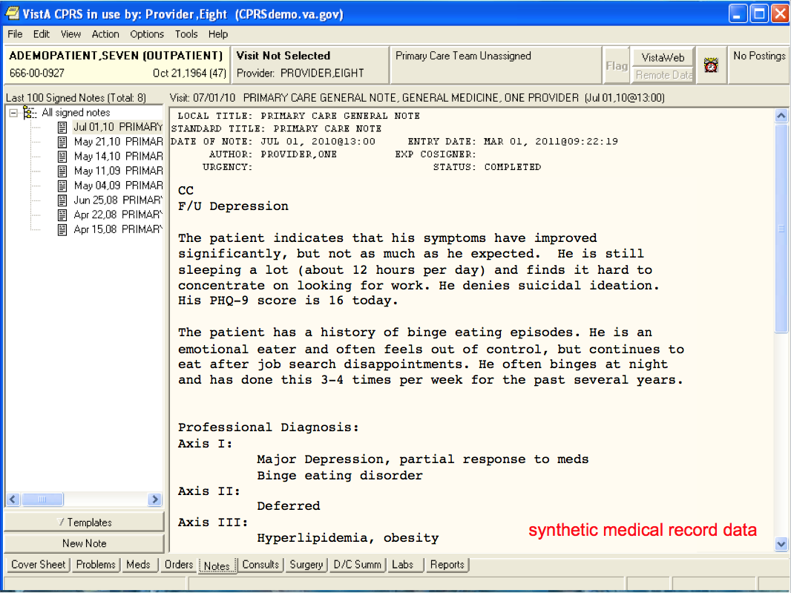
Notes:
One of the powerhouses of CPRS, though, is the ability to capture clinical text. From progress notes, to pathology reports, to radiology reports, to nursing notes, to discharge summaries. The majority of clinical information in the medical record is stored as text. The VA has more than 2 billion of these clinical texts. The Notes package allows clinicians to enter their thoughts freestyle, like as in Notepad or when writing an email. Templates can be created as well – where radio buttons, check boxes, and drop downs can be entered, that are then stored as text. Finally, boilerplate text can be inserted into any note that can pull in information from the medical record – like all current medications or the latest lab values. Of course, the data shown are all synthetic, but notes like this give you an idea of the value of data stored in text. From this note you can see that the sample patient suffers from depression. You also see that the visit is a follow-up to talk about the patient’s depression and some lab work that has been done. With the depression, you can see that there was improvement in some symptoms, but that there are still some symptoms to consider. A Patient Health Questionnaire score is reported. The patient’s past medical history is enumerated along with family medical history. This rich information can answer a whole new level of questions regarding treatment impact, disease progression, and an overall better look at the patient’s underlying state of health.

Slide 9
VA Informatics and Computing Infrastructure
Notes:
The VA Informatics and Computing Infrastructure (VINCI) is a major informatics initiative of the VA to provide researchers access to nation-wide view of all VA patient data. On this map, the green dots represent VA medical centers. Data from each medical center is aggregated into geographic areas called VISNs (Veterans Integrated Service Networks), then into major regional warehouses, then into the national corporate data warehouse. Each of these warehouses serves a different purpose and data is mapped, modeled, and normalized to standardize across sites. The data are then made available on VINCI to VA-credentialed research teams.
VINCI includes a cluster of servers set aside for tasks like analysis (SAS Grid, STATA, etc), data processing, and extracting information from text. This means that VA researchers have access to the data and the applications they need to select, transform, and analyze patient data in a central, secure location inside the VA intranet. VINCI receives data feeds from many sources in the VA and works with other VA groups to validate, link, and describe the available data. Patient information is updated as often as nightly for many clinical elements, providing the most up-to-date view of the care that is happening in the VA. New research projects are granted access to snapshots of data that can be updated as needed.
VINCI is revolutionizing the way studies are performed in the VA and is quickly becoming the preferred source of data for research.

Slide 10



VINCI
Analysis Tools
Nice!
But we still live with resource constraints
Data
Notes:
The VA Informatics and Computing Infrastructure (VINCI) is a major informatics initiative of the VA to provide researchers access to nation-wide view of all VA patient data. On this map, the green dots represent VA medical centers. Data from each medical center is aggregated into geographic areas called VISNs (Veterans Integrated Service Networks), then into major regional warehouses, then into the national corporate data warehouse. Each of these warehouses serves a different purpose and data is mapped, modeled, and normalized to standardize across sites. The data are then made available on VINCI to VA-credentialed research teams.
VINCI includes a cluster of servers set aside for tasks like analysis (SAS Grid, STATA, R, etc), data processing, and extracting information from text. This means that VA researchers have access to the data and the applications they need to select, transform, and analyze patient data in a central, secure location inside the VA intranet. VINCI receives data feeds from many sources in the VA and works with other VA groups to validate, link, and describe the available data. Patient information is updated as often as nightly for many clinical elements, providing the most up-to-date view of the care that is happening in the VA. New research projects are granted access to snapshots of data that can be updated as needed.
VINCI is revolutionizing the way studies are performed in the VA and is quickly becoming the preferred source of data for research.
Live with resource constraints

Slide 11
Research types
NLP research
Output: New methods and tools
Leverage previous theoretical work
Challenges:
Find information
Decode information
Notes:
FIND: Is it recorded? Where? How often? How accurate? In what format?
DECODE: Templated text, abbreviations, telegraphic grammar, specialized vocabularies – secondary use
Methods and tools are end product.

Slide 12
Research types
NLP in clinical research
Output: Clinically relevant data
Leverage existing methods and tools
Challenges:
Project team
Data access
Deployment
Notes:
NLP in clinical research is application of previously developed algorithms to achieve the goals of a clinical study.
Project Team: limited access to qualified individuals… combines clinical + CS (this is what Informatics is good at – bringing the right team together)
For example, our team works on multiple projects in multiple domains with multiple clinical partners – each with different goals, data sources, input and output formats; AND different time and budget constraints
Data Access: Privacy and security, diverse data sources
Deployment: under my control? How much? Can reconfigure? Can install?
This presentation focuses on NLP in clinical research.

Slide 13
Scalability
Scalability of Development
Scalability of Processing
Notes:
When you live in the world of constraints, development of NLP systems for clinical research runs into 2 main scalability issues:
Scalability of development
And
Scalability of processing.
Scalability: Ability of the system to respond to growth, need for capacity.

Slide 14
Scalability of Development
Notes:
Scalability: Ability of the system to respond to growth, need for capacity.
Since we live in the world of constraints, we need to be able to respond to the demands on development of new NLP system. It can be achieved by using reusable modules and packages.
Today we will introduce capabilities of a free source architecture that will allow you to deal with development constraints.

Slide 15
Task 1
Use case:
Extract patient’s alcohol use behavior from clinical text
Labels:
Non-drinker
Current drinker
Past drinker
Unknown
Instance level classification
Notes:
The tutorial is hands on, so we will be working with the following use case as an example of NLP application

Slide 16
Example Regex
Alcohol related term:
etoh
alcohol
dr(i|a)nk\w*
beer
wine
vodka
whiske?y
pint
Notes:
In our example, we have already done the knowledge base acquisition step and decided on the following definitions:
We plan to find mentions of alcohol using the following regex statements

Slide 17
Example Regex
Current drinker:
drink\w* alcohol( rarely)?
rarely drinks( any)? alcohol
drinks infrequent(ly)?( alcohol)?
polysubstance abuse
alcohol abuse
drink\w* socially
beer
glass
has consumed alcohol
Notes:
We will classify mentions as “Current drinker” if alcohol related term is mentioned close to these keywords

Slide 18
Example Regex
Non-Drinker:
no tobacco, alcohol
no alcohol use
non-user of tobacco, alcohol
denies tobacco, etoh
no history of alcohol use
no alcohol use
non-drinker
does not smoke or drink
does not consume alcohol
denies current alcohol use
denies any history of alcohol
denies alcohol
Notes:
We will classify mentions as “Non-drinker” if alcohol related term is mentioned close to these keywords

Slide 19
Example Regex
Past use:
quit drinking
quit alcohol
quit smoking and drinking
quit tobacco and alcohol
stopped drinking
used to drink
history of drinking
hx of alcohol
h/o abuse
h/o\s*(alcohol|etoh)\s*(abuse|dep)?
sobriety
sober
Notes:
We will classify mentions as “Past drinker” if alcohol related term is mentioned close to these keywords

Slide 20
Example Regex
Exclude:
coffee
tea
juice
water
Notes:
If an alcohol related term is mentioned close to these keywords, we will assume that it was an unrelated mention and ignore it.

Slide 21
Task 1: Alcohol Use pipeline
Broker: localhost
JAM: 192.168.1.3
Endpoint name: Demo_YourName
﻿Djava.rmi.server.hostname=192.168.1.6
Readers
Pipeline
Listeners
XMI Files
Database
Regex Alcohol
XMI Listener
Batch database
reader
Window Sectionizer
Delimited file
Regex Past use
CSV listener
Regex Current
Regex Never use
Files
File Reader
Batch database listener
Database
Regex Exclude
Logic
Notes:
So using the described knowledge base we have designed the following pipeline.
The system has multiple steps – reader,
Lets first test that we can all run it
Make sure Broker and Jam are configured
Fix IP in the VM ﻿-Djava.rmi.server.hostname=192.168.1.6

Slide 22
Task 1
Run Alcohol Use pipeline
Look at Service, Client, Pipeline
Notes:
Task 1 includes running a simple pipeline. The task mostly ensures that everyone is able to open the VM and can connect to the router. Introduction to Leo pipeline.
Scalability of development requires:

Slide 23
Scalability of Development
Requirements:
Common infrastructure
Input / Output
Serialization and Transport of Data
Metadata Storage and Indexing
Reusable logic modules
Logic from other platforms can be easily incorporated
Community support
Notes:
Community support includes additional tools that support development – annotation, process monitoring, data storage

Slide 24


Apache UIMA-AS
Notes:
Having a strong architecture is a key to successful development
Reusable logic modules
Logic from other platforms can be easily incorporated
Organized pipelines of modules
Common infrastructure
Serialization and Transport of Data
Metadata Storage and Indexing
Community support
Asynchronous Scale Out (UIMA-AS)
…

Slide 25
Leo
Rapid NLP Development
Programmatically Generate:
UIMA Descriptors
Parameter and Type information for AE
Aggregate AE for a Service
Deployment Configuration
Standard and Custom CollectionReaders
Standard and Custom Listeners
Launch Services and Clients in UIMA-AS
Notes:
Leo enables the following…
Scalable development
Reusable components
Standard design, development process, so easy to pick up
As easy to make a simple to process 100 documents as 100 million documents

Slide 26
Leo
Leo Service
UIMA AS Service
AE
JMX
Input Queue
Reply Queue
Broker
UIMA AS Client
Leo Collection Readers
Leo Client
Leo Listener(s)
https://github.com/department-of-veterans-affairs/Leo
Notes:
And that’s how Leo solves our scalability issues

Slide 27
ChartReview
* Full medical record annotation
Project AEs
- Applied project AEs
- Not-quite Enterprise AEs
eHost
* Document annotation
JAM
* Performance monitoring
Enterprise Quality AEs
RegexAnnotator
AnnotationPattern
ConText
…
Simple Annotation Schema
SimAn
Leo
- Framework
- Annotation management
Any UIMA AS AEs
UIMA AS
Any (non-AS) UIMA Aes such as cTAKES
Chex
* System validation
Any non-UIMA NLP System
Notes:
Besides Leo , additional tools that we have developed help us to speed up the process of development and deployment of NLP solutions.
We will talk about UIMA AS capabilities

Slide 28
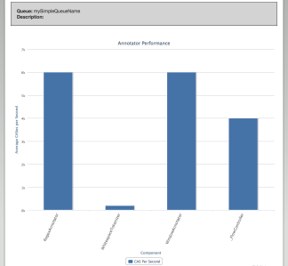
JAM
JMX: Port
UIMA AS
Server 1
JAM
Server
Service 1
Performance Metrics
DB
UIMA AS
Server 2
JMX: Port 1
Service 1
JMX: Port 2
Service 2
Notes:
JAM – JMX Analysis Module – measures the performance of our NLP systems and allows us to identify bottlenecks. We can then reconfigure NLP pipelines for better throughput.
JAM:
Aggregate and Module-specific Statistics
Gathers real-time and Compare Over Time
Standard WAR deployment
Web User Interface

Slide 29
Task 1
Look at JETM
Look at JAM
Notes:
Optimization of pipeline relies on additional tools

Slide 30
Scalability of Processing
Notes:
Scalability: Ability of the system to respond to growth, need for capacity.
Once we design a system, it has to be applied on a large set of documents. Scalability of processing has to be addressed.

Slide 31
Scalability
Readers
Pipeline
Listeners
XMI Files
Database
Regex Alcohol
XMI Listener
Batch database
reader
Window Sectionizer
Concept
Mapping
SQL
Delimited file
Regex Past use
CSV listener
Regex Current
Regex Never use
Patterns
and Rules
Batch database listener
Database
Files
File Reader
Contextual Understanding
Regex Exclude
Logic
Notes:
If we have to process a huge number of possible documents, several break points become evident;
DB timeouts
limits of file systems (large number of files in windows folders)
bottlenecks in processing, SQL – fast, R&P like Regex, fast but specific – manually intensive to create, CM like Metamap or cTAKES slow, more general
I/O processing, number of files, size of files, DB inserts

Slide 32
Apache UIMA-AS
Aggregate AE
Collection Reader
Listener
Analysis Engines (AE)

Slide 33

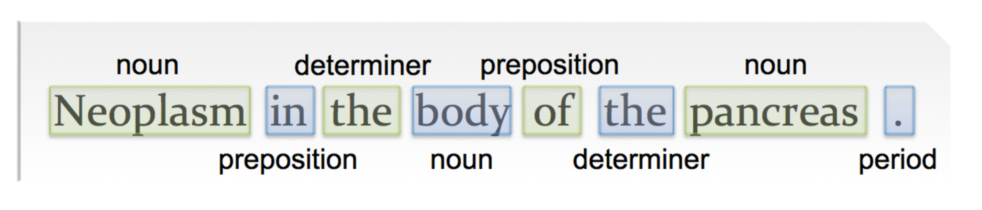
Apache UIMA-AS
Common Analysis
Structure (CAS)
<xmi />
Annotation Type System
Subject of Analysis (SofA)
class PartOfSpeech
extends Annotation_Type
Annotations

Slide 34
Apache UIMA-AS
UIMA AS Service
AE
JMX
Input Queue
Reply Queue
Broker
Collection Reader
UIMA AS Client
Listener(s)
Text becomes CAS
Notes:
Our team evaluated various platforms, including the possibility of writing our own, and eventually chose UIMA.
These are a list of benefits that UIMA provides from our point of view.
It is an enterprise platform, though, so adoption in the VA research community was low. Our goal was to increase adoption.

Slide 35
Task 2: Pause pipeline
Broker: localhost
JAM: 192.168.1.3
Endpoint name: Demo_YourName
Readers
Pipeline
Listeners
Fast Annotator
( pause 250ms )
Files
XMI Files
File Reader
XMI Listener
Medium Annotator
( pause 500ms)
Slow Annotator
( pause 1000ms)
Notes:
What if the pipeline is too slow. If each document takes 250+500+1000 = 1,750 ms + overhead => ~ 1 min for 34 documents
Presenter to run the pipeline and show the console
Everyone, open the configs and check make sure your Broker and JAM IP addresses are set

Slide 36
Task 2: Pause pipeline
Fast Annotator
Medium Annotator
Slow Annotator
Notes:
What if the pipeline is too slow. If each document takes 250+500+1000 = 1,750 ms + overhead => ~ 1 min for 34 documents

Slide 37
Scalability of Processing
Baseline speed: 1 document every ~2 seconds
System
Goal: 2 documents per 1 second
Notes:
Scalability: Ability of the system to respond to growth, need for capacity.
Imagine we have a system that is capable to process 1 document approximately every 2 seconds
Presenter show console!!!
Step 1.

Slide 38
Task 2: Pause pipeline
Fast Annotator
Medium Annotator
Slow Annotator
Fast Annotator
Medium Annotator
Slow Annotator
Notes:
In both cases the total diameter of the pipeline increases so throughput increases as well

Slide 39
Synchronous Scaling
System
1 document
every 2 seconds
4 documents
In 2 seconds
2 documents
per second
Control
Notes:
Scale up
Increase capacity
Everyone – change the name of the service in Service and Client configs
Run once to show the same performance
Change NumberOfInstances to 4
STEP 2
In Demo 2 Task 2 -- run it after changing Number of Instances to 4
Everyone, check JAM website for their run info

Slide 40
Scalability
Baseline speed: 1 document every 2 seconds
System
Goal: 2 documents per 1 second
Notes:
The previous setup works best if all modules in the pipeline perform at similar speed.

Slide 41
Scalability
Baseline speed: 1 document every 2 seconds
System
1 sec
0.25 sec
0.5 sec
Bottleneck in module 3
Notes:
But what if only one of the modules is a bottleneck. It might be best to scaleout only a single modules rather than the whole pipeline.

Slide 42
Asynchronous Scaling
System
1 document
every 2 seconds
2 documents
In 2.5 seconds
1 document
In 1.25 seconds
Control
Notes:
We can only scaleout a single module and the control functionality monitors for modules that completed processing and directs the next document in line to the next open module.
Demo 2 Task 2 Change to async = true and slow annotator number of instances to 2
Repeat with medium annotator number of instances of 2 and slow annotator number of instances =4
Check Jam after each time
STEP 3

Slide 43
Task 2: Pause pipeline
Broker: 192.168.1.3
JAM: 192.168.1.3
Endpoint name: Demo
Readers
Pipeline
Listeners
Fast Annotator
( pause 250ms )
Files
XMI Files
File Reader
XMI Listener
Medium Annotator
( pause 500ms)
Slow Annotator
( pause 1000ms)
Notes:
What if the pipeline is too slow. If each document takes 250+500+1000 = 1,750 ms + overhead => ~ 1 min for 34 documents
Presenter to run the pipeline and show the console

Slide 44
Distributed Synchronous Scaling
System 1
1 document
Every 2 seconds
System 2
4 documents
In 2 seconds
2 documents
per second
Control
System 3
System 4
Notes:
Scale up
Increase capacity and control
Have 4 people run services, presenter runs client!!!
Step 4 – presenter runs client. DISTRIBUTED

Slide 45
Leo
Leo Service
UIMA AS Service
AE
JMX
Input Queue
Reply Queue
Broker
UIMA AS Client
Leo Collection Readers
Leo Client
Leo Listener(s)
https://github.com/department-of-veterans-affairs/Leo
Notes:
And that’s how Leo solves our scalability issues

Slide 46

Leo
Readers
Pipeline
Listeners
XMI Files
Database
Regex Alcohol
XMI Listener
Batch database
reader
Window Sectionizer
Delimited file
Regex Past use
CSV listener
Regex Current
Regex Never use
Files
File Reader
Batch database listener
Database
Regex Exclude
Logic
Notes:
http://farm6.staticflickr.com/5258/5513017364_ff215905e5_z.jpg
Leo and UIMA help to resolve all possible breaking points in development and deployment of NLP pipelines

Slide 47
Leo
Readers
Pipeline
Listeners
XMI Files
Database
Regex Alcohol
XMI Listener
Batch database
reader
Window Sectionizer
Concept
Mapping
SQL
Delimited file
Regex Past use
CSV listener
Regex Current
Regex Never use
Files
File Reader
Patterns
and Rules
Batch database listener
Database
Regex Exclude
Contextual Understanding
Logic
Notes:
http://farm6.staticflickr.com/5258/5513017364_ff215905e5_z.jpg
After scalability issues are solved, you can focus on designing more complex systems.

Slide 48
Questions?
Olga Patterson
olga.patterson@utah.edu
Tom Ginter
thomas.ginter@utah.edu
Scott DuVall
scott.duvall@utah.edu

